Slide 1
Introducing Flask
CTEC 259

Slide 2
Decorators

Slide 3
Python and First Class Functions
“First Class Functions”
When a function can be treated like any other variable in a programming language
In Python, functions are Objects, just like everything else
Some languages that support First Class Functions:
Javascript
Python
Pretty much any language in the Functional paradigm
Languages like C# and Java have started to support similar features in their newer revisions, but the implementation isn’t generally as clear as it is for languages built around the concept from the start

Slide 4
Using Functions as Variables
In python, the name of a function is a variable just like any other
It’s just that this variable references a function, and not a boolean or int
Since functions are variables, we can do wacky stuff:
Pass a function into another function as an argument
Return a function from a function
Set another variable equal to a function

Slide 5
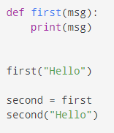
Setting a Variable to a Function

Slide 6
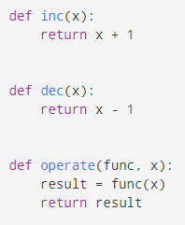

Passing a Function into another Function

Slide 7
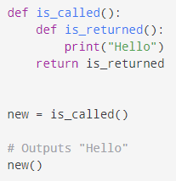
Returning a Function from a Function

Slide 8
So What’s a Decorator?

Slide 9
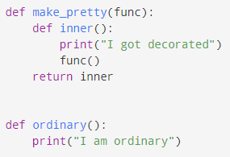
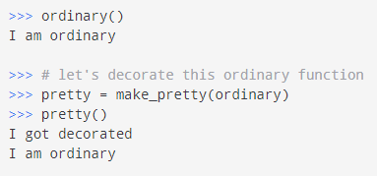
Decorators
To “Decorate” a function is to wrap it in another function so that the functionality of both are used
In short, it adds functionality to an existing function

Slide 10


Syntactic Sugar
Syntactic Sugar - when a language provides multiple ways to write in an operation
Generally, the “Syntactic Sugar” are the versions that are shorter or easier to read
However, this can also make code harder to understand for those who aren’t aware of the sugar
The alternative way to decorate a function in Python is by using the @ symbol

Slide 11
Why are we talking about Decorators?
Flask uses Decorators extensively to simplify your code and make it easier to read
To write code for Flask, you don’t necessarily need to know what a Decorator does
But I hope it helps
How does Flask use Decorators?
Flask keeps a list of all the “endpoints” (such as /index) in your site and the functions to run when they’re requested
When you define one of those functions, you decorate it with a function from Flask
That decorator doesn’t alter your function, but in the background it adds it to the routing list

Slide 12
Using Flask

Slide 13
Initializing Flask
from flask import Flask app = Flask(__name__)
__name__ is a Python variable that represents the “current” module, which creates an understanding of where other files are in relation to the current script
Initializing Flask is made up of:
Importing the Flask class from the flask module
Instantiating a Flask object and storing a reference to it in a variable (in the above case, app)

Slide 14



Routing
A Route is the path of a request
google.com/books would take you to the /books route of google.com
Routes are defined in Flask as decorated functions
The alternative add_url_rule method can also be used
Routes can also pass in dynamic data

Slide 15



Running a Test Server
Two Methods:
Using app.run() in the code
Setting an Environment Variable and starting from the Command Line
Flask’s test server will run on localhost at port 5000
Open your browser and visit localhost:5000 to see your site
This server capability is for development purposes only, and should never be used in a production environment

Slide 16
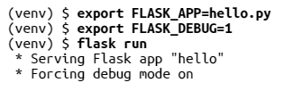
Debug Mode
Though Flask’s server mode is only meant for testing, it doesn’t enable debugging capabilities by default
This means that errors will be hidden by browser output
It also means changes won’t automatically be updated in your test server
Two ways to enable debugging:
Command Line
An argument in app.run()
Never enable debugging on a production server

Slide 17
The Request-Response Cycle
Flask provides data on each site request using pseudo-global objects
Global Variables:
current_app - application instance
g - an object that holds temporary storage, is reset on each request
request - encapsulates the contents of an HTTP request from a client
Can include data from a web form, cookie information and other data sent from the user’s computer
session - user session of information remembered per user between requests
“Sessions” are possible via a combination of cookies on the user’s computer and stored data on the server

Slide 18
The Request Object
Contains request data sent from a Client’s computer
Some useful attributes/methods:
form - a dictionary of form fields submitted with the request
args - a dictionary of arguments passed in the query string
cookies - a dictionary of data stored via cookies for this site
headers - a dictionary of HTTP headers included with the request
files - a dictionary with any file uploads included in the request
url - the complete URL requested by the client

Slide 19

Request Hooks
Implemented as Decorators
Some hooks:
before_request
Will run before every request is handled
before_first_request
WIll run before only the first request the server handles
after_request
Will run after every request assuming no errors
teardown_request
Will run after every request even if there are errors

Slide 20
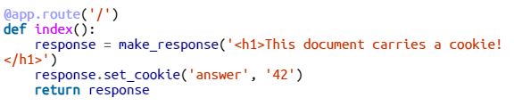
Responses
Flask needs a Response object to send back to users with the data to display (usually HTML)
Flask knows how to convert strings into response objects on its own, but you’ll probably want to define the Response object yourself for more control

Slide 21
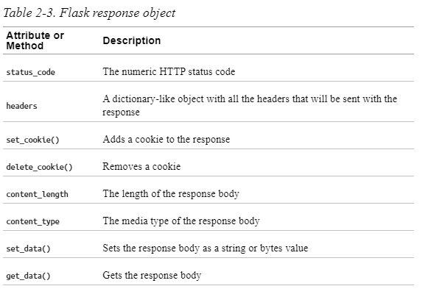

Slide 22

Redirection
Instead of providing data yourself, your URL endpoint can simply redirect to another

